Slide 1
RA Didactics:
Open Health Research
Jon Clucas
October 25, 2018

Slide 2
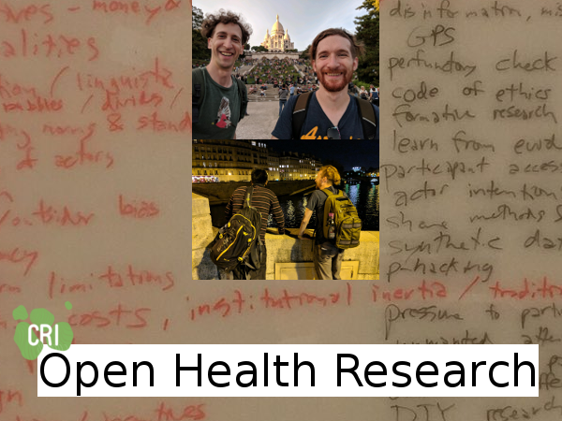

Open Health Research workshop at the CRI
October 10‒12, 2018, Paris, Île-de-France, France
https://matter.childmind.org/open-health-research
#OpenHealthResearch

Slide 3

10 Simple Rules for Ethical Open Health Research with Human Subjects
Design by integrating core ethical principles
https://ethicalos.org/wp-content/uploads/2018/08/EthicalOS_Check-List_080618.pdf

Slide 4

10 Simple Rules for Ethical Open Health Research with Human Subjects
Meaningfully include non-scientist stakeholders for the duration of your projects
0PEN ∫CIENCE 0RGANIZATION
https://www.oso.network

Slide 5

10 Simple Rules for Ethical Open Health Research with Human Subjects
Document what you are doing and what you have done
https://web.hypothes.is

Slide 6

10 Simple Rules for Ethical Open Health Research with Human Subjects
Clarify contributor roles and rewards
https://www.pcori.org/sites/default/files/PCORI-Compensation-Framework-for-Engaged-Research-Partners.pdf

Slide 7

10 Simple Rules for Ethical Open Health Research with Human Subjects
Publish and present accessibly
https://en.wikipedia.org

Slide 8

10 Simple Rules for Ethical Open Health Research with Human Subjects
Practice open methods for all project components, not just publications
https://www.labstep.com/

Slide 9
10 Simple Rules for Ethical Open Health Research with Human Subjects
Acknowledge efforts for openness, and acknowledge lack thereof
Awesome Health
https://github.com/kakoni/awesome-healthcare

Slide 10

10 Simple Rules for Ethical Open Health Research with Human Subjects
Engage politely with others, within and outside your areas of expertise
https://www.reddit.com/r/science

Slide 11

10 Simple Rules for Ethical Open Health Research with Human Subjects
Advocate for open principles
https://www.scienceeurope.org/coalition-s

Slide 12

10 Simple Rules for Ethical Open Health Research with Human Subjects
Take risks as far as you are comfortable to encourage open practices
http://www.nightscout.info

Slide 13
https://matter.childmind.org/open-health-research

